Slide 1
Data Mining: Concepts and Techniques (3rd ed.) — Chapter 10 —
Jiawei Han, Micheline Kamber, and Jian Pei
University of Illinois at Urbana-Champaign &
Simon Fraser University
©2011 Han, Kamber & Pei. All rights reserved.
‹#›
Notes:
‹#›

Slide 2
Chapter 10. Cluster Analysis: Basic Concepts and Methods
Cluster Analysis: Basic Concepts
Partitioning Methods
Hierarchical Methods
Density-Based Methods
Grid-Based Methods
Evaluation of Clustering
Summary
‹#›
‹#›
Notes:
‹#›

Slide 3
What is Cluster Analysis?
Cluster: A collection of data objects
similar (or related) to one another within the same group
dissimilar (or unrelated) to the objects in other groups
Cluster analysis (or clustering, data segmentation, …)
Finding similarities between data according to the characteristics found in the data and grouping similar data objects into clusters
Unsupervised learning: no predefined classes (i.e., learning by observations vs. learning by examples: supervised)
Typical applications
As a stand-alone tool to get insight into data distribution
As a preprocessing step for other algorithms
‹#›
Notes:
‹#›

Slide 4
Clustering for Data Understanding and Applications
Biology: taxonomy of living things: kingdom, phylum, class, order, family, genus and species
Information retrieval: document clustering
Land use: Identification of areas of similar land use in an earth observation database
Marketing: Help marketers discover distinct groups in their customer bases, and then use this knowledge to develop targeted marketing programs
City-planning: Identifying groups of houses according to their house type, value, and geographical location
Earth-quake studies: Observed earth quake epicenters should be clustered along continent faults
Climate: understanding earth climate, find patterns of atmospheric and ocean
Economic Science: market resarch
‹#›
Notes:
‹#›

Slide 5
Clustering as a Preprocessing Tool (Utility)
Summarization:
Preprocessing for regression, PCA, classification, and association analysis
Compression:
Image processing: vector quantization
Finding K-nearest Neighbors
Localizing search to one or a small number of clusters
Outlier detection
Outliers are often viewed as those “far away” from any cluster
‹#›
Notes:
‹#›

Slide 6
Quality: What Is Good Clustering?
A good clustering method will produce high quality clusters
high intra-class similarity: cohesive within clusters
low inter-class similarity: distinctive between clusters
The quality of a clustering method depends on
the similarity measure used by the method
its implementation, and
Its ability to discover some or all of the hidden patterns
‹#›
Notes:
‹#›

Slide 7
Measure the Quality of Clustering
Dissimilarity/Similarity metric
Similarity is expressed in terms of a distance function, typically metric: d(i, j)
The definitions of distance functions are usually rather different for interval-scaled, boolean, categorical, ordinal ratio, and vector variables
Weights should be associated with different variables based on applications and data semantics
Quality of clustering:
There is usually a separate “quality” function that measures the “goodness” of a cluster.
It is hard to define “similar enough” or “good enough”
The answer is typically highly subjective
‹#›
Notes:
‹#›

Slide 8
Considerations for Cluster Analysis
Partitioning criteria
Single level vs. hierarchical partitioning (often, multi-level hierarchical partitioning is desirable)
Separation of clusters
Exclusive (e.g., one customer belongs to only one region) vs. non-exclusive (e.g., one document may belong to more than one class)
Similarity measure
Distance-based (e.g., Euclidian, road network, vector) vs. connectivity-based (e.g., density or contiguity)
Clustering space
Full space (often when low dimensional) vs. subspaces (often in high-dimensional clustering)
‹#›

Slide 9
Requirements and Challenges
Scalability
Clustering all the data instead of only on samples
Ability to deal with different types of attributes
Numerical, binary, categorical, ordinal, linked, and mixture of these
Constraint-based clustering
User may give inputs on constraints
Use domain knowledge to determine input parameters
Interpretability and usability
Others
Discovery of clusters with arbitrary shape
Ability to deal with noisy data
Incremental clustering and insensitivity to input order
High dimensionality
‹#›

Slide 10
Major Clustering Approaches (I)
Partitioning approach:
Construct various partitions and then evaluate them by some criterion, e.g., minimizing the sum of square errors
Typical methods: k-means, k-medoids, CLARANS
Hierarchical approach:
Create a hierarchical decomposition of the set of data (or objects) using some criterion
Typical methods: Diana, Agnes, BIRCH, CAMELEON
Density-based approach:
Based on connectivity and density functions
Typical methods: DBSACN, OPTICS, DenClue
Grid-based approach:
based on a multiple-level granularity structure
Typical methods: STING, WaveCluster, CLIQUE
‹#›
Notes:
‹#›

Slide 11
Major Clustering Approaches (II)
Model-based:
A model is hypothesized for each of the clusters and tries to find the best fit of that model to each other
Typical methods: EM, SOM, COBWEB
Frequent pattern-based:
Based on the analysis of frequent patterns
Typical methods: p-Cluster
User-guided or constraint-based:
Clustering by considering user-specified or application-specific constraints
Typical methods: COD (obstacles), constrained clustering
Link-based clustering:
Objects are often linked together in various ways
Massive links can be used to cluster objects: SimRank, LinkClus
‹#›
Notes:
‹#›

Slide 12
Chapter 10. Cluster Analysis: Basic Concepts and Methods
Cluster Analysis: Basic Concepts
Partitioning Methods
Hierarchical Methods
Density-Based Methods
Grid-Based Methods
Evaluation of Clustering
Summary
‹#›
‹#›
Notes:
‹#›

Slide 13
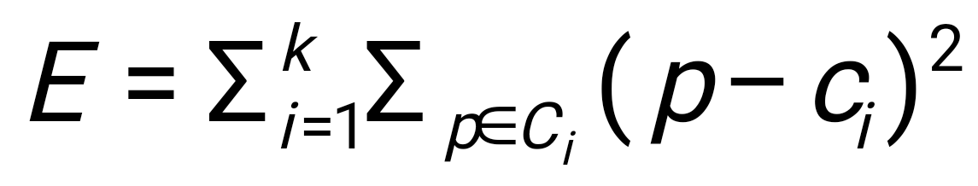
Partitioning Algorithms: Basic Concept
Partitioning method: Partitioning a database D of n objects into a set of k clusters, such that the sum of squared distances is minimized (where c_{i} is the centroid or medoid of cluster C_{i})
Given k, find a partition of k clusters that optimizes the chosen partitioning criterion
Global optimal: exhaustively enumerate all partitions
Heuristic methods: k-means and k-medoids algorithms
k-means (MacQueen’67, Lloyd’57/’82): Each cluster is represented by the center of the cluster
k-medoids or PAM (Partition around medoids) (Kaufman & Rousseeuw’87): Each cluster is represented by one of the objects in the cluster
‹#›
Notes:
‹#›

Slide 14
The K-Means Clustering Method
Given k, the k-means algorithm is implemented in four steps:
Partition objects into k nonempty subsets
Compute seed points as the centroids of the clusters of the current partitioning (the centroid is the center, i.e., mean point, of the cluster)
Assign each object to the cluster with the nearest seed point
Go back to Step 2, stop when the assignment does not change
‹#›
Notes:
‹#›

Slide 15
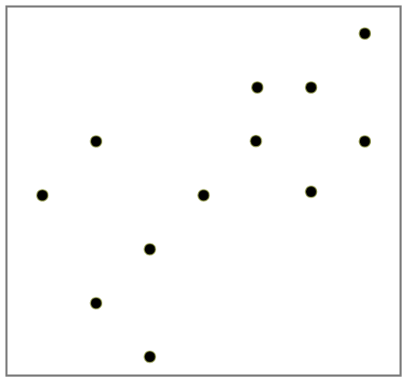
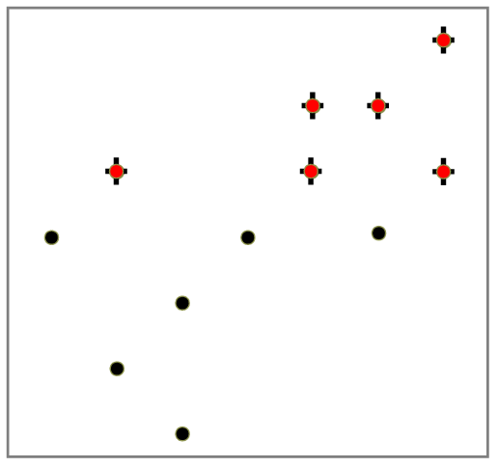
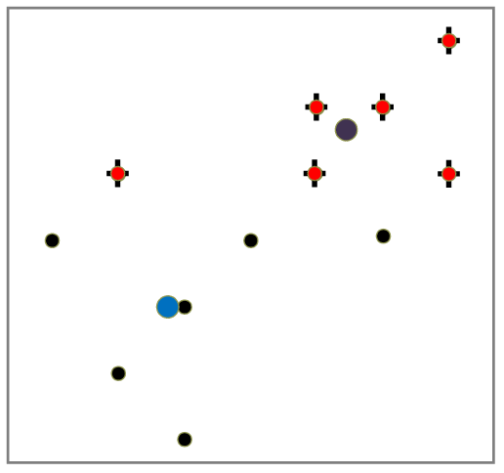
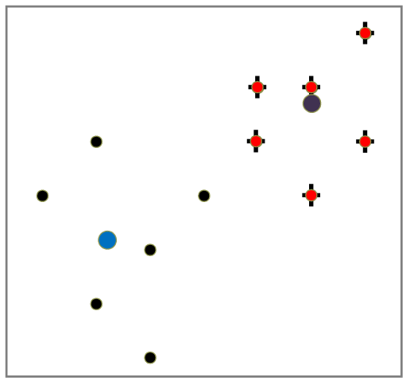
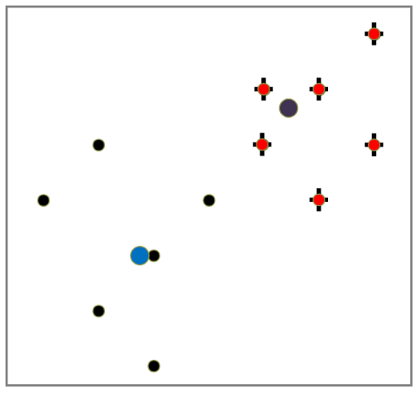
An Example of K-Means Clustering
K=2
Arbitrarily partition objects into k groups
Update the cluster centroids
The initial data set
Loop if needed
Reassign objects
Partition objects into k nonempty subsets
Repeat
Compute centroid (i.e., mean point) for each partition
Assign each object to the cluster of its nearest centroid
Until no change
Update the cluster centroids
‹#›
Notes:
‹#›

Slide 16
Comments on the K-Means Method
Strength: Efficient: O(tkn), where n is # objects, k is # clusters, and t is # iterations. Normally, k, t << n.
Comparing: PAM: O(k(n-k)² ), CLARA: O(ks² + k(n-k))
Comment: Often terminates at a local optimal.
Weakness
Applicable only to objects in a continuous n-dimensional space
Using the k-modes method for categorical data
In comparison, k-medoids can be applied to a wide range of data
Need to specify k, the number of clusters, in advance (there are ways to automatically determine the best k (see Hastie et al., 2009)
Sensitive to noisy data and outliers
Not suitable to discover clusters with non-convex shapes
‹#›
Notes:
‹#›

Slide 17
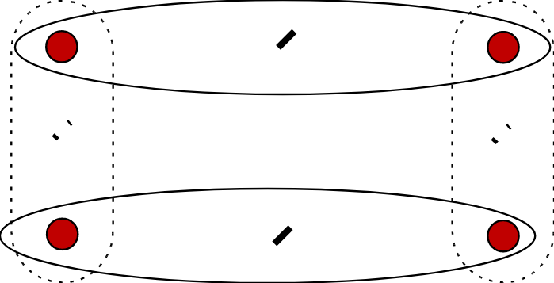
Variations of the K-Means Method
Most of the variants of the k-means which differ in
Selection of the initial k means
Dissimilarity calculations
Strategies to calculate cluster means
Handling categorical data: k-modes
Replacing means of clusters with modes
Using new dissimilarity measures to deal with categorical objects
Using a frequency-based method to update modes of clusters
A mixture of categorical and numerical data: k-prototype method
‹#›
Notes:
‹#›

Slide 18
What Is the Problem of the K-Means Method?
The k-means algorithm is sensitive to outliers !
Since an object with an extremely large value may substantially distort the distribution of the data
K-Medoids: Instead of taking the mean value of the object in a cluster as a reference point, medoids can be used, which is the most centrally located object in a cluster
10
10
9
9
8
8
7
7
6
6
5
5
4
4
3
3
2
2
1
1
0
0
1
2
3
4
5
6
7
8
9
10
0
0
1
2
3
4
5
6
7
8
9
10
‹#›
Notes:
‹#›

Slide 19
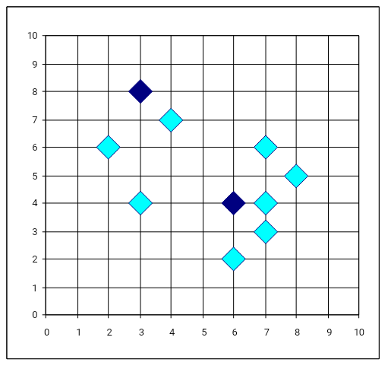
PAM: A Typical K-Medoids Algorithm
Total Cost = 20
10
9
8
Arbitrary choose k object as initial medoids
Assign each remaining object to nearest medoids
7
6
5
4
3
2
1
0
0
1
2
3
4
5
6
7
8
9
10
K=2
Randomly select a nonmedoid object,O_{ramdom}
Total Cost = 26
Do loop
Until no change
10
10
9
Compute total cost of swapping
9
Swapping O and O_{ramdom}
If quality is improved.
8
8
7
7
6
6
5
5
4
4
3
3
2
2
1
1
0
0
1
2
3
4
5
6
7
8
9
10
0
0
1
‹#›
2
3
4
5
6
7
8
9
10
Notes:
‹#›

Slide 20
The K-Medoid Clustering Method
K-Medoids Clustering: Find representative objects (medoids) in clusters
PAM (Partitioning Around Medoids, Kaufmann & Rousseeuw 1987)
Starts from an initial set of medoids and iteratively replaces one of the medoids by one of the non-medoids if it improves the total distance of the resulting clustering
PAM works effectively for small data sets, but does not scale well for large data sets (due to the computational complexity)
Efficiency improvement on PAM
CLARA (Kaufmann & Rousseeuw, 1990): PAM on samples
CLARANS (Ng & Han, 1994): Randomized re-sampling
‹#›
Notes:
‹#›

Slide 21
Chapter 10. Cluster Analysis: Basic Concepts and Methods
Cluster Analysis: Basic Concepts
Partitioning Methods
Hierarchical Methods
Density-Based Methods
Grid-Based Methods
Evaluation of Clustering
Summary
‹#›
‹#›
Notes:
‹#›

Slide 22
Hierarchical Clustering
Use distance matrix as clustering criteria. This method does not require the number of clusters k as an input, but needs a termination condition
Step 0
Step 1
Step 2
Step 3
Step 4
agglomerative
(AGNES)
a
a b
b
a b c d e
c
c d e
d
d e
e
divisive
(DIANA)
Step 4
Step 3
Step 2
Step 1
Step 0
‹#›
Notes:
‹#›

Slide 23
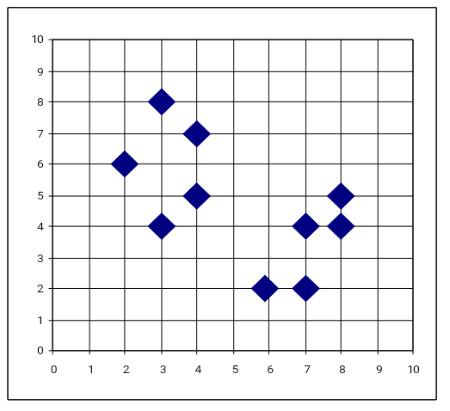
AGNES (Agglomerative Nesting)
Introduced in Kaufmann and Rousseeuw (1990)
Implemented in statistical packages, e.g., Splus
Use the single-link method and the dissimilarity matrix
Merge nodes that have the least dissimilarity
Go on in a non-descending fashion
Eventually all nodes belong to the same cluster
‹#›
Notes:
‹#›

Slide 24
Dendrogram: Shows How Clusters are Merged
Decompose data objects into a several levels of nested partitioning (tree of clusters), called a dendrogram
A clustering of the data objects is obtained by cutting the dendrogram at the desired level, then each connected component forms a cluster
‹#›
Notes:
‹#›

Slide 25
DIANA (Divisive Analysis)
Introduced in Kaufmann and Rousseeuw (1990)
Implemented in statistical analysis packages, e.g., Splus
Inverse order of AGNES
Eventually each node forms a cluster on its own
‹#›
Notes:
‹#›

Slide 26
Distance between Clusters
X
X
Single link: smallest distance between an element in one cluster and an element in the other, i.e., dist(K_{i}, K_{j}) = min(t_{ip}, t_{jq})
Complete link: largest distance between an element in one cluster and an element in the other, i.e., dist(K_{i}, K_{j}) = max(t_{ip}, t_{jq})
Average: avg distance between an element in one cluster and an element in the other, i.e., dist(K_{i}, K_{j}) = avg(t_{ip}, t_{jq})
Centroid: distance between the centroids of two clusters, i.e., dist(K_{i}, K_{j}) = dist(C_{i}, C_{j})
Medoid: distance between the medoids of two clusters, i.e., dist(K_{i}, K_{j}) = dist(M_{i}, M_{j})
Medoid: a chosen, centrally located object in the cluster
‹#›
Notes:
‹#›

Slide 27
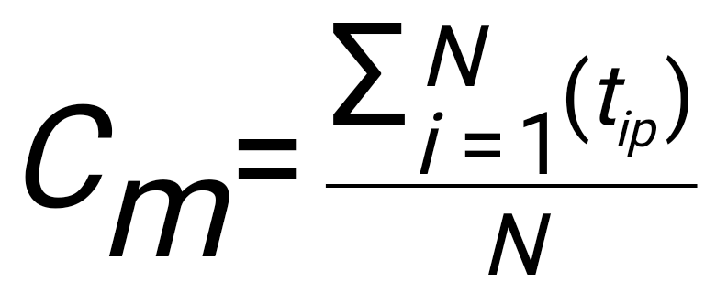
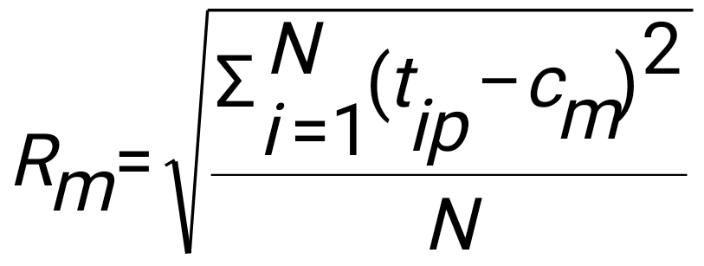
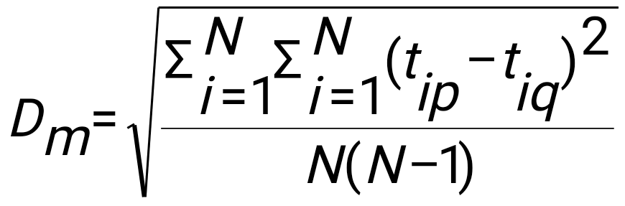
Centroid, Radius and Diameter of a Cluster (for numerical data sets)
Centroid: the “middle” of a cluster
Radius: square root of average distance from any point of the cluster to its centroid
Diameter: square root of average mean squared distance between all pairs of points in the cluster
‹#›
Notes:
‹#›

Slide 28
Extensions to Hierarchical Clustering
Major weakness of agglomerative clustering methods
Can never undo what was done previously
Do not scale well: time complexity of at least O(n²), where n is the number of total objects
Integration of hierarchical & distance-based clustering
BIRCH (1996): uses CF-tree and incrementally adjusts the quality of sub-clusters
CHAMELEON (1999): hierarchical clustering using dynamic modeling
‹#›
Notes:
‹#›

Slide 29
BIRCH (Balanced Iterative Reducing and Clustering Using Hierarchies)
Zhang, Ramakrishnan & Livny, SIGMOD’96
Incrementally construct a CF (Clustering Feature) tree, a hierarchical data structure for multiphase clustering
Phase 1: scan DB to build an initial in-memory CF tree (a multi-level compression of the data that tries to preserve the inherent clustering structure of the data)
Phase 2: use an arbitrary clustering algorithm to cluster the leaf nodes of the CF-tree
Scales linearly: finds a good clustering with a single scan and improves the quality with a few additional scans
Weakness: handles only numeric data, and sensitive to the order of the data record
‹#›
Notes:
‹#›

Slide 30
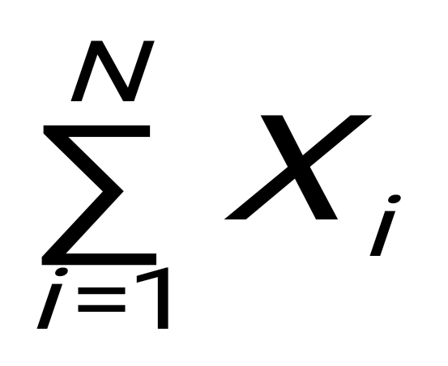
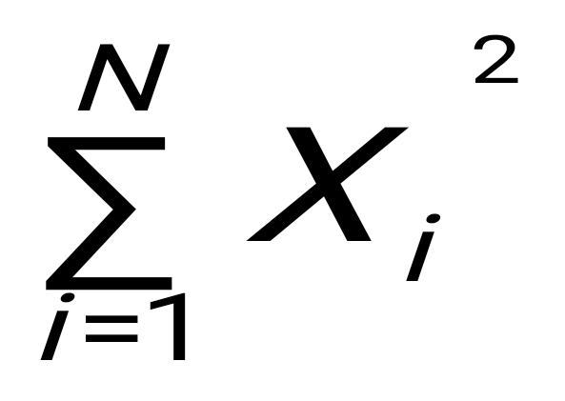
Clustering Feature Vector in BIRCH
Clustering Feature (CF): CF = (N, LS, SS)
N: Number of data points
LS: linear sum of N points:
SS: square sum of N points
CF = (5, (16,30),(54,190))
(3,4)
(2,6)
(4,5)
(4,7)
(3,8)
‹#›
Notes:
‹#›

Slide 31
CF-Tree in BIRCH
Clustering feature:
Summary of the statistics for a given subcluster: the 0-th, 1st, and 2nd moments of the subcluster from the statistical point of view
Registers crucial measurements for computing cluster and utilizes storage efficiently
A CF tree is a height-balanced tree that stores the clustering features for a hierarchical clustering
A nonleaf node in a tree has descendants or “children”
The nonleaf nodes store sums of the CFs of their children
A CF tree has two parameters
Branching factor: max # of children
Threshold: max diameter of sub-clusters stored at the leaf nodes
‹#›
Notes:
‹#›

Slide 32
The CF Tree Structure
Root
B = 7
L = 6
CF₁
CF₂
CF₃
CF₆
child₁
child₂
child₃
child₆
Non-leaf node
CF₁
CF₂
CF₃
CF₅
child₁
child₂
child₃
child₅
Leaf node
Leaf node
prev
CF₁
CF₂
CF₆
next
prev
CF₁
CF₂
CF₄
next
‹#›
Notes:
‹#›

Slide 33
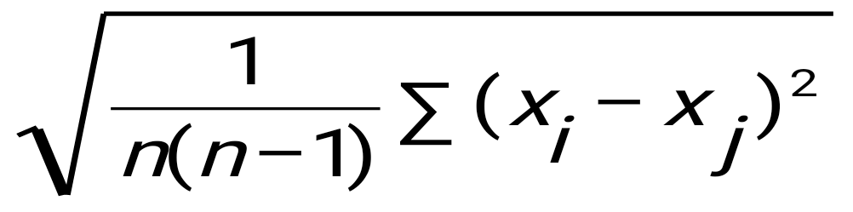
The Birch Algorithm
Cluster Diameter
For each point in the input
Find closest leaf entry
Add point to leaf entry and update CF
If entry diameter > max_diameter, then split leaf, and possibly parents
Algorithm is O(n)
Concerns
Sensitive to insertion order of data points
Since we fix the size of leaf nodes, so clusters may not be so natural
Clusters tend to be spherical given the radius and diameter measures
‹#›
Notes:
‹#›

Slide 34
CHAMELEON: Hierarchical Clustering Using Dynamic Modeling (1999)
CHAMELEON: G. Karypis, E. H. Han, and V. Kumar, 1999
Measures the similarity based on a dynamic model
Two clusters are merged only if the interconnectivity and closeness (proximity) between two clusters are high relative to the internal interconnectivity of the clusters and closeness of items within the clusters
Graph-based, and a two-phase algorithm
Use a graph-partitioning algorithm: cluster objects into a large number of relatively small sub-clusters
Use an agglomerative hierarchical clustering algorithm: find the genuine clusters by repeatedly combining these sub-clusters
‹#›
Notes:
‹#›

Slide 35
Overall Framework of CHAMELEON
Construct (K-NN)
Sparse Graph
Partition the Graph
Data Set
K-NN Graph
P and q are connected if q is among the top k closest neighbors of p
Merge Partition
Relative interconnectivity: connectivity of c₁ and c₂ over internal connectivity
Relative closeness: closeness of c₁ and c₂ over internal closeness
Final Clusters
‹#›
Notes:
‹#›

Slide 36
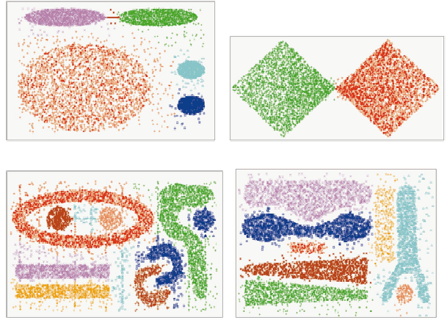
CHAMELEON (Clustering Complex Objects)
‹#›
Notes:
‹#›

Slide 37
Probabilistic Hierarchical Clustering
Algorithmic hierarchical clustering
Nontrivial to choose a good distance measure
Hard to handle missing attribute values
Optimization goal not clear: heuristic, local search
Probabilistic hierarchical clustering
Use probabilistic models to measure distances between clusters
Generative model: Regard the set of data objects to be clustered as a sample of the underlying data generation mechanism to be analyzed
Easy to understand, same efficiency as algorithmic agglomerative clustering method, can handle partially observed data
In practice, assume the generative models adopt common distributions functions, e.g., Gaussian distribution or Bernoulli distribution, governed by parameters
‹#›

Slide 38
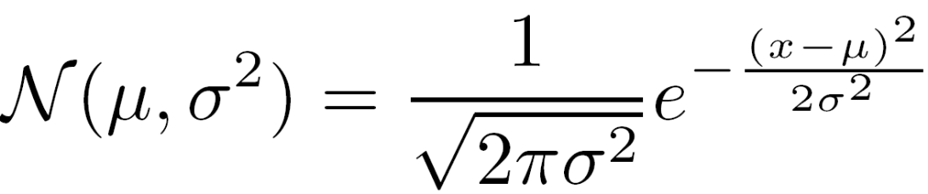
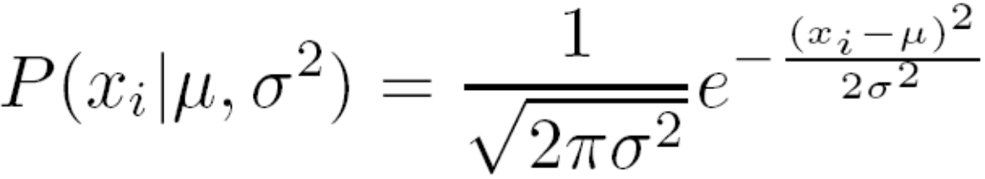

Generative Model
Given a set of 1-D points X = {x₁, …, x_{n}} for clustering analysis & assuming they are generated by a Gaussian distribution:
The probability that a point x_{i} ∈ X is generated by the model
The likelihood that X is generated by the model:
The task of learning the generative model: find the parameters μ and σ² such that
the maximum likelihood
‹#›

Slide 39

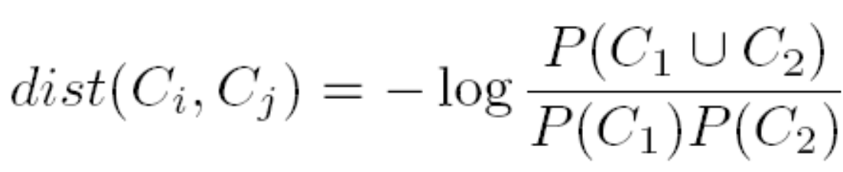
A Probabilistic Hierarchical Clustering Algorithm
For a set of objects partitioned into m clusters C₁, . . . ,C_{m}, the quality can be measured by,
where P() is the maximum likelihood
Distance between clusters C₁ and C₂:
Algorithm: Progressively merge points and clusters
Input: D = {o₁, ..., o_{n}}: a data set containing n objects
Output: A hierarchy of clusters
Method
Create a cluster for each object C_{i} = {o_{i}}, 1 ≤ i ≤ n;
For i = 1 to n {
Find pair of clusters C_{i} and C_{j} such that
C_{i},C_{j} = argmax_{i ≠ j} {log (P(C_{i}∪C_{j} )/(P(C_{i})P(C_{j} ))};
If log (P(C_{i}∪C_{j} )/(P(C_{i})P(C_{j} )) > 0 then merge C_{i} and C_{j} }
‹#›

Slide 40
Chapter 10. Cluster Analysis: Basic Concepts and Methods
Cluster Analysis: Basic Concepts
Partitioning Methods
Hierarchical Methods
Density-Based Methods
Grid-Based Methods
Evaluation of Clustering
Summary
‹#›
‹#›
Notes:
‹#›

Slide 41
Density-Based Clustering Methods
Clustering based on density (local cluster criterion), such as density-connected points
Major features:
Discover clusters of arbitrary shape
Handle noise
One scan
Need density parameters as termination condition
Several interesting studies:
DBSCAN: Ester, et al. (KDD’96)
OPTICS: Ankerst, et al (SIGMOD’99).
DENCLUE: Hinneburg & D. Keim (KDD’98)
CLIQUE: Agrawal, et al. (SIGMOD’98) (more grid-based)
‹#›
Notes:
‹#›

Slide 42
Density-Based Clustering: Basic Concepts
Two parameters:
Eps: Maximum radius of the neighbourhood
MinPts: Minimum number of points in an Eps-neighbourhood of that point
N_{Eps}(p): {q belongs to D | dist(p,q) ≤ Eps}
Directly density-reachable: A point p is directly density-reachable from a point q w.r.t. Eps, MinPts if
p belongs to N_{Eps}(q)
core point condition:
|N_{Eps} (q)| ≥ MinPts
p
MinPts = 5
Eps = 1 cm
q
‹#›
Notes:
‹#›

Slide 43
Density-Reachable and Density-Connected
Density-reachable:
A point p is density-reachable from a point q w.r.t. Eps, MinPts if there is a chain of points p₁, …, p_{n}, p₁ = q, p_{n} = p such that p_{i+1} is directly density-reachable from p_{i}
Density-connected
A point p is density-connected to a point q w.r.t. Eps, MinPts if there is a point o such that both, p and q are density-reachable from o w.r.t. Eps and MinPts
p
p₁
q
p
q
o
‹#›
Notes:
‹#›

Slide 44
DBSCAN: Density-Based Spatial Clustering of Applications with Noise
Relies on a density-based notion of cluster: A cluster is defined as a maximal set of density-connected points
Discovers clusters of arbitrary shape in spatial databases with noise
Outlier
Border
Eps = 1cm
MinPts = 5
Core
‹#›
Notes:
‹#›

Slide 45
DBSCAN: The Algorithm
Arbitrary select a point p
Retrieve all points density-reachable from p w.r.t. Eps and MinPts
If p is a core point, a cluster is formed
If p is a border point, no points are density-reachable from p and DBSCAN visits the next point of the database
Continue the process until all of the points have been processed
‹#›
Notes:
‹#›

Slide 46
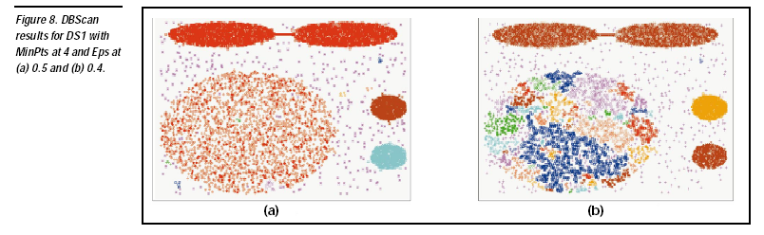

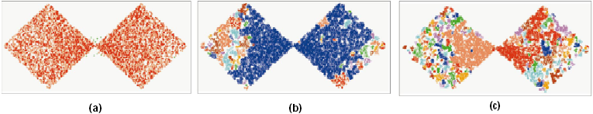
DBSCAN: Sensitive to Parameters
‹#›
Notes:
‹#›

Slide 47
OPTICS: A Cluster-Ordering Method (1999)
OPTICS: Ordering Points To Identify the Clustering Structure
Ankerst, Breunig, Kriegel, and Sander (SIGMOD’99)
Produces a special order of the database wrt its density-based clustering structure
This cluster-ordering contains info equiv to the density-based clusterings corresponding to a broad range of parameter settings
Good for both automatic and interactive cluster analysis, including finding intrinsic clustering structure
Can be represented graphically or using visualization techniques
‹#›
Notes:
‹#›

Slide 48
OPTICS: Some Extension from DBSCAN
Index-based:
k = number of dimensions
N = 20
p = 75%
M = N(1-p) = 5
Complexity: O(NlogN)
Core Distance:
min eps s.t. point is core
Reachability Distance
D
p1
o
p2
o
Max (core-distance (o), d (o, p))
r(p1, o) = 2.8cm. r(p2,o) = 4cm
MinPts = 5
ε = 3 cm
‹#›
Notes:
‹#›

Slide 49
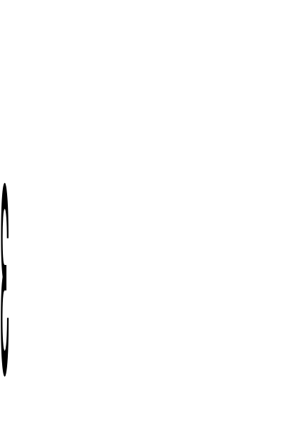
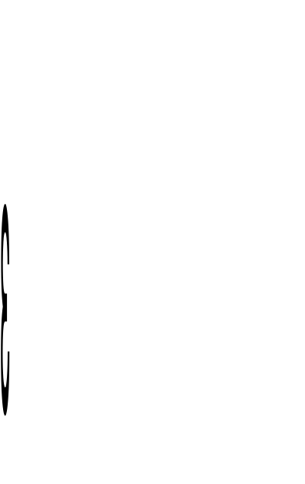
Reachability-distance
undefined
‘
Cluster-order
of the objects
‹#›
Notes:
‹#›

Slide 50
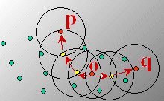
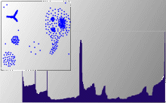
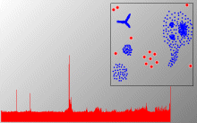
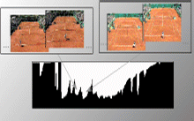
Density-Based Clustering: OPTICS & Its Applications
‹#›
Notes:
‹#›

Slide 51
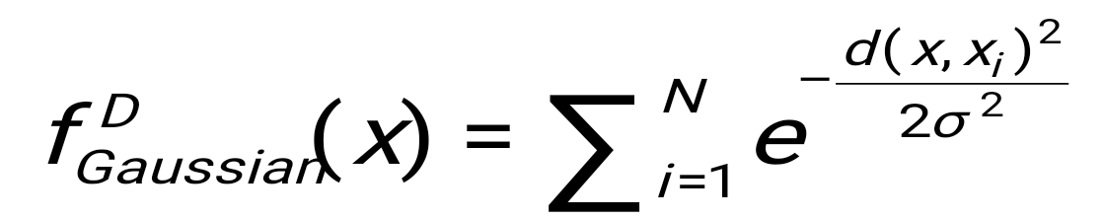
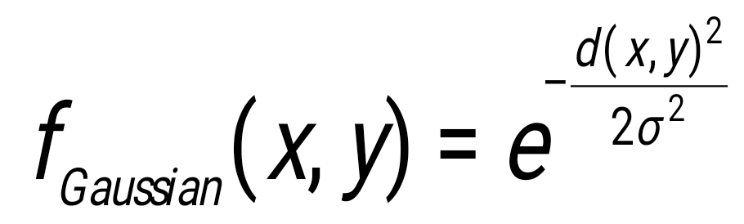
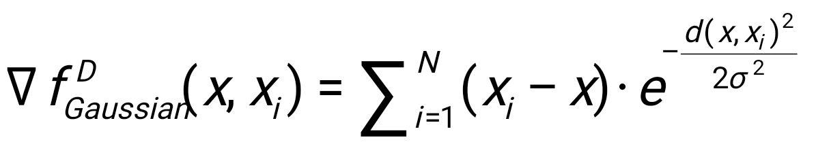
DENCLUE: Using Statistical Density Functions
DENsity-based CLUstEring by Hinneburg & Keim (KDD’98)
Using statistical density functions:
Major features
Solid mathematical foundation
Good for data sets with large amounts of noise
Allows a compact mathematical description of arbitrarily shaped clusters in high-dimensional data sets
Significant faster than existing algorithm (e.g., DBSCAN)
But needs a large number of parameters
total influence on x
influence of y on x
gradient of x in the direction of x_{i}
‹#›
Notes:
‹#›

Slide 52
Denclue: Technical Essence
Uses grid cells but only keeps information about grid cells that do actually contain data points and manages these cells in a tree-based access structure
Influence function: describes the impact of a data point within its neighborhood
Overall density of the data space can be calculated as the sum of the influence function of all data points
Clusters can be determined mathematically by identifying density attractors
Density attractors are local maximal of the overall density function
Center defined clusters: assign to each density attractor the points density attracted to it
Arbitrary shaped cluster: merge density attractors that are connected through paths of high density (> threshold)
‹#›
Notes:
‹#›

Slide 53
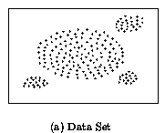
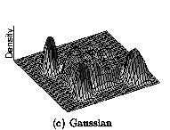
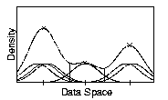
Density Attractor
‹#›
Notes:
‹#›

Slide 54
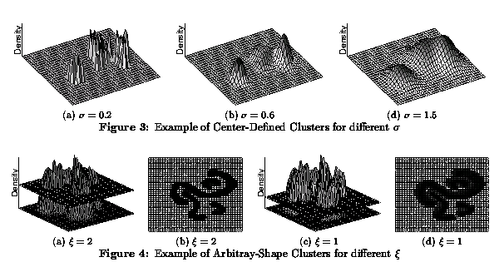
Center-Defined and Arbitrary
‹#›
Notes:
‹#›

Slide 55
Chapter 10. Cluster Analysis: Basic Concepts and Methods
Cluster Analysis: Basic Concepts
Partitioning Methods
Hierarchical Methods
Density-Based Methods
Grid-Based Methods
Evaluation of Clustering
Summary
‹#›
‹#›
Notes:
‹#›

Slide 56
Grid-Based Clustering Method
Using multi-resolution grid data structure
Several interesting methods
STING (a STatistical INformation Grid approach) by Wang, Yang and Muntz (1997)
WaveCluster by Sheikholeslami, Chatterjee, and Zhang (VLDB’98)
A multi-resolution clustering approach using wavelet method
CLIQUE: Agrawal, et al. (SIGMOD’98)
Both grid-based and subspace clustering
‹#›
Notes:
‹#›

Slide 57
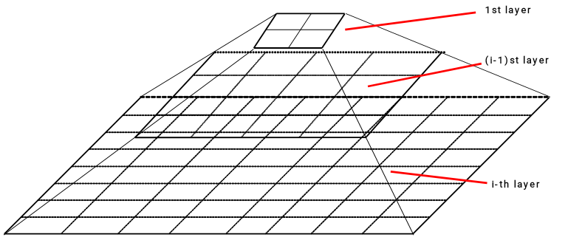
STING: A Statistical Information Grid Approach
Wang, Yang and Muntz (VLDB’97)
The spatial area is divided into rectangular cells
There are several levels of cells corresponding to different levels of resolution
‹#›
Notes:
‹#›

Slide 58
The STING Clustering Method
Each cell at a high level is partitioned into a number of smaller cells in the next lower level
Statistical info of each cell is calculated and stored beforehand and is used to answer queries
Parameters of higher level cells can be easily calculated from parameters of lower level cell
count, mean, s, min, max
type of distribution—normal, uniform, etc.
Use a top-down approach to answer spatial data queries
Start from a pre-selected layer—typically with a small number of cells
For each cell in the current level compute the confidence interval
‹#›
Notes:
‹#›

Slide 59
STING Algorithm and Its Analysis
Remove the irrelevant cells from further consideration
When finish examining the current layer, proceed to the next lower level
Repeat this process until the bottom layer is reached
Advantages:
Query-independent, easy to parallelize, incremental update
O(K), where K is the number of grid cells at the lowest level
Disadvantages:
All the cluster boundaries are either horizontal or vertical, and no diagonal boundary is detected
‹#›
Notes:
‹#›

Slide 60
CLIQUE (Clustering In QUEst)
Agrawal, Gehrke, Gunopulos, Raghavan (SIGMOD’98)
Automatically identifying subspaces of a high dimensional data space that allow better clustering than original space
CLIQUE can be considered as both density-based and grid-based
It partitions each dimension into the same number of equal length interval
It partitions an m-dimensional data space into non-overlapping rectangular units
A unit is dense if the fraction of total data points contained in the unit exceeds the input model parameter
A cluster is a maximal set of connected dense units within a subspace
‹#›
Notes:
‹#›

Slide 61
CLIQUE: The Major Steps
Partition the data space and find the number of points that lie inside each cell of the partition.
Identify the subspaces that contain clusters using the Apriori principle
Identify clusters
Determine dense units in all subspaces of interests
Determine connected dense units in all subspaces of interests.
Generate minimal description for the clusters
Determine maximal regions that cover a cluster of connected dense units for each cluster
Determination of minimal cover for each cluster
‹#›
Notes:
‹#›

Slide 62
Salary (10,000)
Vacation(week)
7
7
6
6
5
5
4
4
3
3
2
2
1
1
age
0
age
0
20
30
40
50
60
20
30
40
50
60
τ = 3
Vacation
Salary
30
50
age
‹#›
Notes:
‹#›

Slide 63
Strength and Weakness of CLIQUE
Strength
automatically finds subspaces of the highest dimensionality such that high density clusters exist in those subspaces
insensitive to the order of records in input and does not presume some canonical data distribution
scales linearly with the size of input and has good scalability as the number of dimensions in the data increases
Weakness
The accuracy of the clustering result may be degraded at the expense of simplicity of the method
‹#›
Notes:
‹#›

Slide 64
Chapter 10. Cluster Analysis: Basic Concepts and Methods
Cluster Analysis: Basic Concepts
Partitioning Methods
Hierarchical Methods
Density-Based Methods
Grid-Based Methods
Evaluation of Clustering
Summary
‹#›
‹#›
Notes:
‹#›

Slide 65
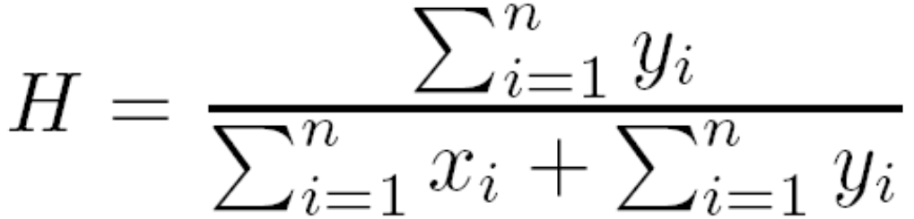
Assessing Clustering Tendency
Assess if non-random structure exists in the data by measuring the probability that the data is generated by a uniform data distribution
Test spatial randomness by statistic test: Hopkins Static
Given a dataset D regarded as a sample of a random variable o, determine how far away o is from being uniformly distributed in the data space
Sample n points, p₁, …, p_{n}, uniformly from D. For each p_{i}, find its nearest neighbor in D: x_{i} = min{dist (p_{i}, v)} where v in D
Sample n points, q₁, …, q_{n}, uniformly from D. For each q_{i}, find its nearest neighbor in D – {q_{i}}: y_{i} = min{dist (q_{i}, v)} where v in D and v ≠ q_{i}
Calculate the Hopkins Statistic:
If D is uniformly distributed, ∑ x_{i} and ∑ y_{i} will be close to each other and H is close to 0.5. If D is highly skewed, H is close to 0
‹#›

Slide 66
Determine the Number of Clusters
Empirical method
# of clusters ≈√n/2 for a dataset of n points
Elbow method
Use the turning point in the curve of sum of within cluster variance w.r.t the # of clusters
Cross validation method
Divide a given data set into m parts
Use m – 1 parts to obtain a clustering model
Use the remaining part to test the quality of the clustering
E.g., For each point in the test set, find the closest centroid, and use the sum of squared distance between all points in the test set and the closest centroids to measure how well the model fits the test set
For any k > 0, repeat it m times, compare the overall quality measure w.r.t. different k’s, and find # of clusters that fits the data the best
‹#›

Slide 67
Measuring Clustering Quality
Two methods: extrinsic vs. intrinsic
Extrinsic: supervised, i.e., the ground truth is available
Compare a clustering against the ground truth using certain clustering quality measure
Ex. BCubed precision and recall metrics
Intrinsic: unsupervised, i.e., the ground truth is unavailable
Evaluate the goodness of a clustering by considering how well the clusters are separated, and how compact the clusters are
Ex. Silhouette coefficient
‹#›

Slide 68
Measuring Clustering Quality: Extrinsic Methods
Clustering quality measure: Q(C, C_{g}), for a clustering C given the ground truth C_{g}.
Q is good if it satisfies the following 4 essential criteria
Cluster homogeneity: the purer, the better
Cluster completeness: should assign objects belong to the same category in the ground truth to the same cluster
Rag bag: putting a heterogeneous object into a pure cluster should be penalized more than putting it into a rag bag (i.e., “miscellaneous” or “other” category)
Small cluster preservation: splitting a small category into pieces is more harmful than splitting a large category into pieces
‹#›

Slide 69
Chapter 10. Cluster Analysis: Basic Concepts and Methods
Cluster Analysis: Basic Concepts
Partitioning Methods
Hierarchical Methods
Density-Based Methods
Grid-Based Methods
Evaluation of Clustering
Summary
‹#›
‹#›
Notes:
‹#›

Slide 70
Summary
Cluster analysis groups objects based on their similarity and has wide applications
Measure of similarity can be computed for various types of data
Clustering algorithms can be categorized into partitioning methods, hierarchical methods, density-based methods, grid-based methods, and model-based methods
K-means and K-medoids algorithms are popular partitioning-based clustering algorithms
Birch and Chameleon are interesting hierarchical clustering algorithms, and there are also probabilistic hierarchical clustering algorithms
DBSCAN, OPTICS, and DENCLU are interesting density-based algorithms
STING and CLIQUE are grid-based methods, where CLIQUE is also a subspace clustering algorithm
Quality of clustering results can be evaluated in various ways
‹#›
Notes:
‹#›

Slide 71
CS512-Spring 2011: An Introduction
Coverage
Cluster Analysis: Chapter 11
Outlier Detection: Chapter 12
Mining Sequence Data: BK2: Chapter 8
Mining Graphs Data: BK2: Chapter 9
Social and Information Network Analysis
BK2: Chapter 9
Partial coverage: Mark Newman: “Networks: An Introduction”, Oxford U., 2010
Scattered coverage: Easley and Kleinberg, “Networks, Crowds, and Markets: Reasoning About a Highly Connected World”, Cambridge U., 2010
Recent research papers
Mining Data Streams: BK2: Chapter 8
Requirements
One research project
One class presentation (15 minutes)
Two homeworks (no programming assignment)
Two midterm exams (no final exam)
‹#›
Notes:
‹#›
‹#›

Slide 72
References (1)
R. Agrawal, J. Gehrke, D. Gunopulos, and P. Raghavan. Automatic subspace clustering of high dimensional data for data mining applications. SIGMOD'98
M. R. Anderberg. Cluster Analysis for Applications. Academic Press, 1973.
M. Ankerst, M. Breunig, H.-P. Kriegel, and J. Sander. Optics: Ordering points to identify the clustering structure, SIGMOD’99.
Beil F., Ester M., Xu X.: "Frequent Term-Based Text Clustering", KDD'02
M. M. Breunig, H.-P. Kriegel, R. Ng, J. Sander. LOF: Identifying Density-Based Local Outliers. SIGMOD 2000.
M. Ester, H.-P. Kriegel, J. Sander, and X. Xu. A density-based algorithm for discovering clusters in large spatial databases. KDD'96.
M. Ester, H.-P. Kriegel, and X. Xu. Knowledge discovery in large spatial databases: Focusing techniques for efficient class identification. SSD'95.
D. Fisher. Knowledge acquisition via incremental conceptual clustering. Machine Learning, 2:139-172, 1987.
D. Gibson, J. Kleinberg, and P. Raghavan. Clustering categorical data: An approach based on dynamic systems. VLDB’98.
V. Ganti, J. Gehrke, R. Ramakrishan. CACTUS Clustering Categorical Data Using Summaries. KDD'99.
‹#›
Notes:
‹#›

Slide 73
References (2)
D. Gibson, J. Kleinberg, and P. Raghavan. Clustering categorical data: An approach based on dynamic systems. In Proc. VLDB’98.
S. Guha, R. Rastogi, and K. Shim. Cure: An efficient clustering algorithm for large databases. SIGMOD'98.
S. Guha, R. Rastogi, and K. Shim. ROCK: A robust clustering algorithm for categorical attributes. In ICDE'99, pp. 512-521, Sydney, Australia, March 1999.
A. Hinneburg, D.l A. Keim: An Efficient Approach to Clustering in Large Multimedia Databases with Noise. KDD’98.
A. K. Jain and R. C. Dubes. Algorithms for Clustering Data. Printice Hall, 1988.
G. Karypis, E.-H. Han, and V. Kumar. CHAMELEON: A Hierarchical Clustering Algorithm Using Dynamic Modeling. COMPUTER, 32(8): 68-75, 1999.
L. Kaufman and P. J. Rousseeuw. Finding Groups in Data: an Introduction to Cluster Analysis. John Wiley & Sons, 1990.
E. Knorr and R. Ng. Algorithms for mining distance-based outliers in large datasets. VLDB’98.
‹#›
Notes:
‹#›

Slide 74
References (3)
G. J. McLachlan and K.E. Bkasford. Mixture Models: Inference and Applications to Clustering. John Wiley and Sons, 1988.
R. Ng and J. Han. Efficient and effective clustering method for spatial data mining. VLDB'94.
L. Parsons, E. Haque and H. Liu, Subspace Clustering for High Dimensional Data: A Review, SIGKDD Explorations, 6(1), June 2004
E. Schikuta. Grid clustering: An efficient hierarchical clustering method for very large data sets. Proc. 1996 Int. Conf. on Pattern Recognition
G. Sheikholeslami, S. Chatterjee, and A. Zhang. WaveCluster: A multi-resolution clustering approach for very large spatial databases. VLDB’98.
A. K. H. Tung, J. Han, L. V. S. Lakshmanan, and R. T. Ng. Constraint-Based Clustering in Large Databases, ICDT'01.
A. K. H. Tung, J. Hou, and J. Han. Spatial Clustering in the Presence of Obstacles, ICDE'01
H. Wang, W. Wang, J. Yang, and P.S. Yu. Clustering by pattern similarity in large data sets, SIGMOD’02
W. Wang, Yang, R. Muntz, STING: A Statistical Information grid Approach to Spatial Data Mining, VLDB’97
T. Zhang, R. Ramakrishnan, and M. Livny. BIRCH : An efficient data clustering method for very large databases. SIGMOD'96
X. Yin, J. Han, and P. S. Yu, “LinkClus: Efficient Clustering via Heterogeneous Semantic Links”, VLDB'06
‹#›
Notes:
‹#›

Slide 75
Slides unused in class
‹#›
Notes:
‹#›

Slide 76
A Typical K-Medoids Algorithm (PAM)
Total Cost = 20
10
9
8
Arbitrary choose k object as initial medoids
Assign each remaining object to nearest medoids
7
6
5
4
3
2
1
0
0
1
2
3
4
5
6
7
8
9
10
K=2
Randomly select a nonmedoid object,O_{ramdom}
Total Cost = 26
Do loop
Until no change
10
10
9
Compute total cost of swapping
9
Swapping O and O_{ramdom}
If quality is improved.
8
8
7
7
6
6
5
5
4
4
3
3
2
2
1
1
0
0
1
2
3
4
5
6
7
8
9
10
0
0
1
‹#›
2
3
4
5
6
7
8
9
10
Notes:
‹#›

Slide 77
PAM (Partitioning Around Medoids) (1987)
PAM (Kaufman and Rousseeuw, 1987), built in Splus
Use real object to represent the cluster
Select k representative objects arbitrarily
For each pair of non-selected object h and selected object i, calculate the total swapping cost TC_{ih}
For each pair of i and h,
If TC_{ih} < 0, i is replaced by h
Then assign each non-selected object to the most similar representative object
repeat steps 2-3 until there is no change
‹#›
Notes:
‹#›

Slide 78
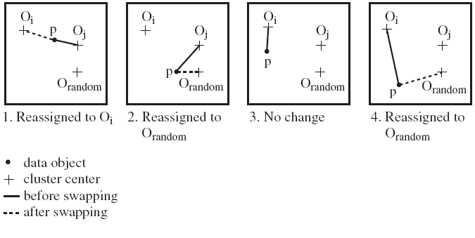
PAM Clustering: Finding the Best Cluster Center
Case 1: p currently belongs to o_{j}. If o_{j} is replaced by o_{random} as a representative object and p is the closest to one of the other representative object o_{i}, then p is reassigned to o_{i}
‹#›
Notes:
‹#›

Slide 79
What Is the Problem with PAM?
Pam is more robust than k-means in the presence of noise and outliers because a medoid is less influenced by outliers or other extreme values than a mean
Pam works efficiently for small data sets but does not scale well for large data sets.
O(k(n-k)² ) for each iteration
where n is # of data,k is # of clusters
Sampling-based method
CLARA(Clustering LARge Applications)
‹#›
Notes:
‹#›

Slide 80
CLARA (Clustering Large Applications) (1990)
CLARA (Kaufmann and Rousseeuw in 1990)
Built in statistical analysis packages, such as SPlus
It draws multiple samples of the data set, applies PAM on each sample, and gives the best clustering as the output
Strength: deals with larger data sets than PAM
Weakness:
Efficiency depends on the sample size
A good clustering based on samples will not necessarily represent a good clustering of the whole data set if the sample is biased
‹#›
Notes:
‹#›

Slide 81
CLARANS (“Randomized” CLARA) (1994)
CLARANS (A Clustering Algorithm based on Randomized Search) (Ng and Han’94)
Draws sample of neighbors dynamically
The clustering process can be presented as searching a graph where every node is a potential solution, that is, a set of k medoids
If the local optimum is found, it starts with new randomly selected node in search for a new local optimum
Advantages: More efficient and scalable than both PAM and CLARA
Further improvement: Focusing techniques and spatial access structures (Ester et al.’95)
‹#›
Notes:
‹#›

Slide 82
ROCK: Clustering Categorical Data
ROCK: RObust Clustering using linKs
S. Guha, R. Rastogi & K. Shim, ICDE’99
Major ideas
Use links to measure similarity/proximity
Not distance-based
Algorithm: sampling-based clustering
Draw random sample
Cluster with links
Label data in disk
Experiments
Congressional voting, mushroom data
‹#›
Notes:
‹#›

Slide 83
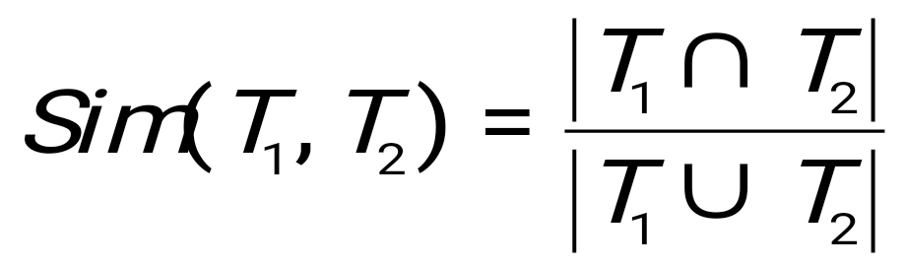
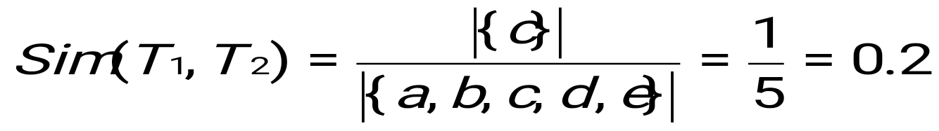
Similarity Measure in ROCK
Traditional measures for categorical data may not work well, e.g., Jaccard coefficient
Example: Two groups (clusters) of transactions
C₁. <a, b, c, d, e>: {a, b, c}, {a, b, d}, {a, b, e}, {a, c, d}, {a, c, e}, {a, d, e}, {b, c, d}, {b, c, e}, {b, d, e}, {c, d, e}
C₂. <a, b, f, g>: {a, b, f}, {a, b, g}, {a, f, g}, {b, f, g}
Jaccard co-efficient may lead to wrong clustering result
C₁: 0.2 ({a, b, c}, {b, d, e}} to 0.5 ({a, b, c}, {a, b, d})
C₁ & C₂: could be as high as 0.5 ({a, b, c}, {a, b, f})
Jaccard co-efficient-based similarity function:
Ex. Let T₁ = {a, b, c}, T₂ = {c, d, e}
‹#›
Notes:
‹#›

Slide 84
Link Measure in ROCK
Clusters
C₁:<a, b, c, d, e>: {a, b, c}, {a, b, d}, {a, b, e}, {a, c, d}, {a, c, e}, {a, d, e}, {b, c, d}, {b, c, e}, {b, d, e}, {c, d, e}
C₂: <a, b, f, g>: {a, b, f}, {a, b, g}, {a, f, g}, {b, f, g}
Neighbors
Two transactions are neighbors if sim(T₁,T₂) > threshold
Let T₁ = {a, b, c}, T₂ = {c, d, e}, T₃ = {a, b, f}
T₁ connected to: {a,b,d}, {a,b,e}, {a,c,d}, {a,c,e}, {b,c,d}, {b,c,e}, {a,b,f}, {a,b,g}
T₂ connected to: {a,c,d}, {a,c,e}, {a,d,e}, {b,c,e}, {b,d,e}, {b,c,d}
T₃ connected to: {a,b,c}, {a,b,d}, {a,b,e}, {a,b,g}, {a,f,g}, {b,f,g}
Link Similarity
Link similarity between two transactions is the # of common neighbors
link(T_{1,} T₂) = 4, since they have 4 common neighbors
{a, c, d}, {a, c, e}, {b, c, d}, {b, c, e}
link(T_{1,} T₃) = 3, since they have 3 common neighbors
{a, b, d}, {a, b, e}, {a, b, g}
‹#›
Notes:
‹#›

Slide 85
Rock Algorithm
Method
Compute similarity matrix
Use link similarity
Run agglomerative hierarchical clustering
When the data set is big
Get sample of transactions
Cluster sample
Problems:
Guarantee cluster interconnectivity
any two transactions in a cluster are very well connected
Ignores information about closeness of two clusters
two separate clusters may still be quite connected
‹#›
Notes:
‹#›

Slide 86
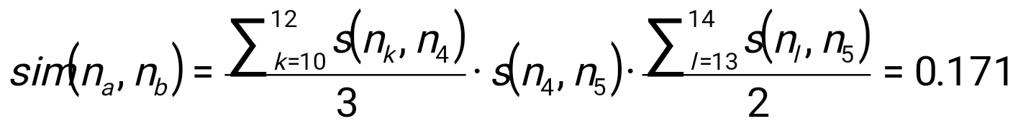
Aggregation-Based Similarity Computation
0.2
ST₂
4
5
0.9
1.0
0.8
0.9
1.0
10
11
12
13
14
ST₁
a
b
For each node n_{k} ∈ {n₁₀, n₁₁, n₁₂} and n_{l} ∈ {n₁₃, n₁₄}, their path-based similarity sim_{p}(n_{k}, n_{l}) = s(n_{k}, n₄)·s(n₄, n₅)·s(n₅, n_{l}).
takes O(3+2) time
After aggregation, we reduce quadratic time computation to linear time computation.
‹#›
Notes:
‹#›

Slide 87
Computing Similarity with Aggregation
Average similarity
and total weight
a:(0.9,3)
b:(0.95,2)
0.2
4
5
sim(n_{a}, n_{b}) can be computed from aggregated similarities
10
11
12
13
14
a
b
sim(n_{a}, n_{b}) = avg_sim(n_{a},n₄) x s(n₄, n₅) x avg_sim(n_{b},n₅)
= 0.9 x 0.2 x 0.95 = 0.171
To compute sim(n_{a},n_{b}):
Find all pairs of sibling nodes n_{i} and n_{j}, so that n_{a} linked with n_{i} and n_{b} with n_{j}.
Calculate similarity (and weight) between n_{a} and n_{b} w.r.t. n_{i} and n_{j}.
Calculate weighted average similarity between n_{a} and n_{b} w.r.t. all such pairs.
‹#›
Notes:
‹#›

Slide 88
Chapter 10. Cluster Analysis: Basic Concepts and Methods
Cluster Analysis: Basic Concepts
Overview of Clustering Methods
Partitioning Methods
Hierarchical Methods
Density-Based Methods
Grid-Based Methods
Summary
‹#›
‹#›
Notes:
‹#›

Slide 89
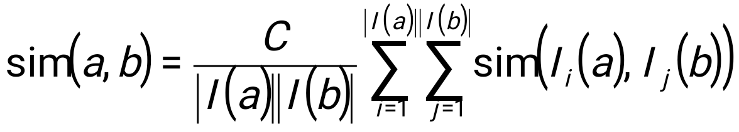
Link-Based Clustering: Calculate Similarities Based On Links
Authors
Proceedings
Conferences
The similarity between two objects x and y is defined as the average similarity between objects linked with x and those with y:
Issue: Expensive to compute:
For a dataset of N objects and M links, it takes O(N²) space and O(M²) time to compute all similarities.
Tom
sigmod03
sigmod04
sigmod
Mike
sigmod05
vldb03
Cathy
vldb04
vldb
John
vldb05
aaai04
aaai
Mary
aaai05
Jeh & Widom, KDD’2002: SimRank
Two objects are similar if they are linked with the same or similar objects
‹#›
Notes:
‹#›

Slide 90
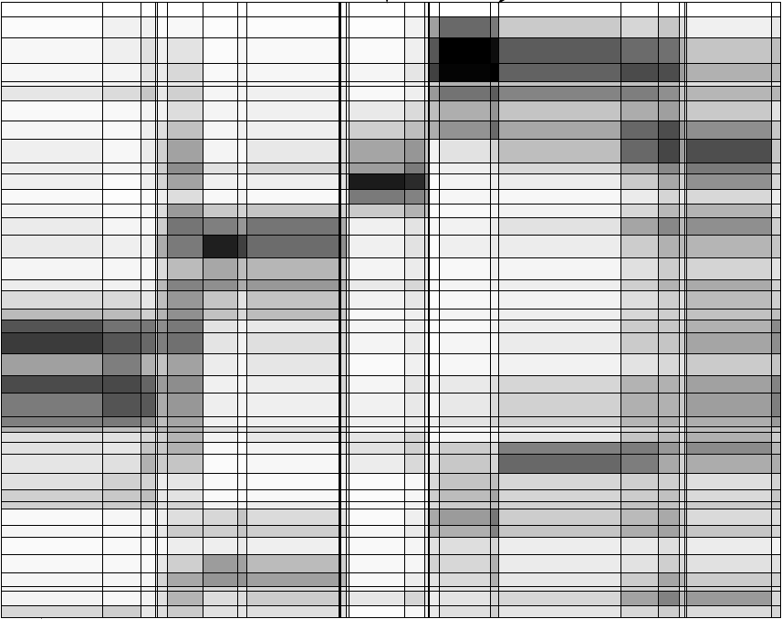
Observation 1: Hierarchical Structures
Hierarchical structures often exist naturally among objects (e.g., taxonomy of animals)
Relationships between articles and words (Chakrabarti, Papadimitriou, Modha, Faloutsos, 2004)
A hierarchical structure of products in Walmart
All
grocery
electronics
apparel
Articles
TV
DVD
camera
Words
‹#›
Notes:
‹#›

Slide 91
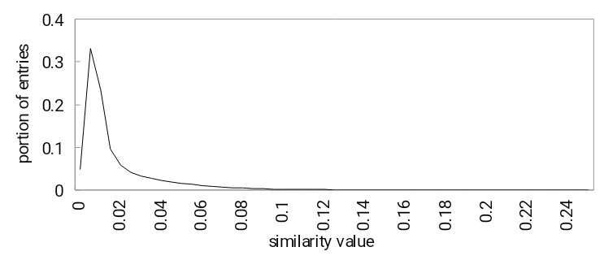
Observation 2: Distribution of Similarity
Distribution of SimRank similarities among DBLP authors
Power law distribution exists in similarities
56% of similarity entries are in [0.005, 0.015]
1.4% of similarity entries are larger than 0.1
Can we design a data structure that stores the significant similarities and compresses insignificant ones?
‹#›
Notes:
‹#›

Slide 92
A Novel Data Structure: SimTree
Each leaf node represents an object
Each non-leaf node represents a group of similar lower-level nodes
Similarities between siblings are stored
Canon A40 digital camera
Digital Cameras
Sony V3 digital camera
Consumer electronics
Apparels
TVs
‹#›
Notes:
‹#›

Slide 93
Similarity Defined by SimTree
Similarity between two sibling nodes n₁ and n₂
n₁
0.2
n₂
n₃
Adjustment ratio for node n₇
0.8
0.9
0.9
0.3
n₄
n₅
n₆
0.9
0.8
1.0
n₇
n₈
n₉
Path-based node similarity
sim_{p}(n₇,n₈) = s(n₇, n₄) x s(n₄, n₅) x s(n₅, n₈)
Similarity between two nodes is the average similarity between objects linked with them in other SimTrees
Adjust/ ratio for x =
Average similarity between x and all other nodes
Average similarity between x’s parent and all other nodes
‹#›
Notes:
‹#›

Slide 94
LinkClus: Efficient Clustering via Heterogeneous Semantic Links
Method
Initialize a SimTree for objects of each type
Repeat until stable
For each SimTree, update the similarities between its nodes using similarities in other SimTrees
Similarity between two nodes x and y is the average similarity between objects linked with them
Adjust the structure of each SimTree
Assign each node to the parent node that it is most similar to
For details: X. Yin, J. Han, and P. S. Yu, “LinkClus: Efficient Clustering via Heterogeneous Semantic Links”, VLDB'06
‹#›
Notes:
‹#›

Slide 95
Initialization of SimTrees
Initializing a SimTree
Repeatedly find groups of tightly related nodes, which are merged into a higher-level node
Tightness of a group of nodes
For a group of nodes {n₁, …, n_{k}}, its tightness is defined as the number of leaf nodes in other SimTrees that are connected to all of {n₁, …, n_{k}}
Nodes
Leaf nodes in another SimTree
n₁
1
2
The tightness of {n₁, n₂} is 3
3
n₂
4
5
‹#›
Notes:
‹#›
We use this simple definition of tightness for efficiency concerns.

Slide 96
Finding Tight Groups by Freq. Pattern Mining
Finding tight groups Frequent pattern mining
Procedure of initializing a tree
Start from leaf nodes (level-0)
At each level l, find non-overlapping groups of similar nodes with frequent pattern mining
Reduced to
Transactions
1
{n1}
The tightness of a group of nodes is the support of a frequent pattern
n₁
g₁
{n1, n2}
2
{n2}
n₂
3
{n1, n2}
4
{n1, n2}
5
{n2, n3, n4}
n₃
6
g₂
{n4}
7
{n3, n4}
n₄
8
{n3, n4}
9
‹#›
Notes:
‹#›

Slide 97
Adjusting SimTree Structures
n₁
n₂
n₃
0.9
0.8
n₄
n₅
n₆
n₇
n₇
n₈
n₉
After similarity changes, the tree structure also needs to be changed
If a node is more similar to its parent’s sibling, then move it to be a child of that sibling
Try to move each node to its parent’s sibling that it is most similar to, under the constraint that each parent node can have at most c children
‹#›
Notes:
‹#›

Slide 98
Complexity
For two types of objects, N in each, and M linkages between them.
 | Time | Space
Updating similarities | O(M(logN)²) | O(M+N)
Adjusting tree structures | O(N) | O(N)
LinkClus | O(M(logN)²) | O(M+N)
SimRank | O(M²) | O(N²)
‹#›
Notes:
‹#›

Slide 99
Experiment: Email Dataset
F. Nielsen. Email dataset. www.imm.dtu.dk/~rem/data/Email-1431.zip
370 emails on conferences, 272 on jobs, and 789 spam emails
Accuracy: measured by manually labeled data
Accuracy of clustering: % of pairs of objects in the same cluster that share common label
Approach | Accuracy | time (s)
LinkClus | 0.8026 | 1579.6
SimRank | 0.7965 | 39160
ReCom | 0.5711 | 74.6
F-SimRank | 0.3688 | 479.7
CLARANS | 0.4768 | 8.55
Approaches compared:
SimRank (Jeh & Widom, KDD 2002): Computing pair-wise similarities
SimRank with FingerPrints (F-SimRank): Fogaras & R´acz, WWW 2005
pre-computes a large sample of random paths from each object and uses samples of two objects to estimate SimRank similarity
ReCom (Wang et al. SIGIR 2003)
Iteratively clustering objects using cluster labels of linked objects
‹#›
Notes:
‹#›

Slide 100
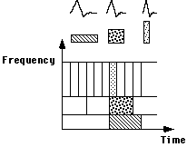
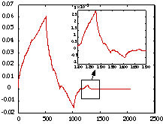
WaveCluster: Clustering by Wavelet Analysis (1998)
Sheikholeslami, Chatterjee, and Zhang (VLDB’98)
A multi-resolution clustering approach which applies wavelet transform to the feature space; both grid-based and density-based
Wavelet transform: A signal processing technique that decomposes a signal into different frequency sub-band
Data are transformed to preserve relative distance between objects at different levels of resolution
Allows natural clusters to become more distinguishable
‹#›
Notes:
‹#›

Slide 101
The WaveCluster Algorithm
How to apply wavelet transform to find clusters
Summarizes the data by imposing a multidimensional grid structure onto data space
These multidimensional spatial data objects are represented in a n-dimensional feature space
Apply wavelet transform on feature space to find the dense regions in the feature space
Apply wavelet transform multiple times which result in clusters at different scales from fine to coarse
Major features:
Complexity O(N)
Detect arbitrary shaped clusters at different scales
Not sensitive to noise, not sensitive to input order
Only applicable to low dimensional data
‹#›
Notes:
‹#›

Slide 102
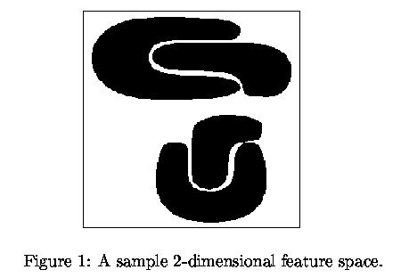
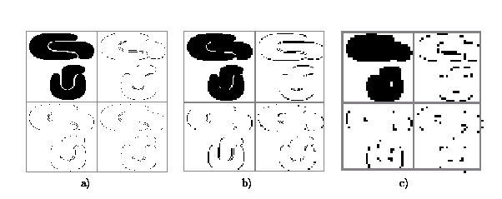
Quantization & Transformation
Quantize data into m-D grid structure, then wavelet transform
a) scale 1: high resolution
b) scale 2: medium resolution
c) scale 3: low resolution
‹#›
Notes:
‹#›

